Slide 1

Institute of Aeronautical Engineering
(Autonomous)
Department of Electrical and Electronics Engineering
IOT BASED SMART AGRICULTURE MONITORING SYSTEM
Batch Members
20955A0241–S.Sravankumar
19951A0249–J.Saikumar
20955A0248– K.V.R.S.Jayakar
Supervisor Name
Mr.A.Srikanth
Assistant Professor
Electrical and Electronics Engineering
Date: 06/12/2021

Slide 2
Abstract
Agriculture is done in every country from ages. Agriculture is the science and art of cultivating plants. Agriculture was the key development in the rise of sedentary human civilization. Agriculture is done manually from ages. As the world is trending into new technologies and implementations it is a necessary goal to trend up with agriculture also. IOT plays a very important role in smart agriculture. IOT sensors are capable of providing information about agriculture fields. we have proposed an IOT and smart agriculture system using automation. This IOT based Agriculture monitoring system makes use of wireless sensor networks that collects data from different sensors deployed at various nodes and sends it through the wireless protocol. This smart agriculture using IOT system is powered by Arduino, it consists of Temperature sensor, Moisture sensor, water level sensor, DC motor and GPRS module.

Slide 3
Abstract
When the IOT based agriculture monitoring system starts it checks the water level, humidity and moisture level. It sends SMS alert on the phone about the levels. Sensors sense the level of water if it goes down, it automatically starts the water pump. If the temperature goes above the level, fan starts. This all is displayed on the LCD display module. This all is also seen in IOT where it shows information of Humidity, Moisture and water level with date and time, based on per minute. Temperature can be set on a particular level, it is based on the type crops cultivated. If we want to close the water forcefully on IOT there is button given from where water pump can be forcefully stopped.

Slide 4
Introduction
IoT based smart agriculture monitoring helps in collecting data, starting from the weather conditions to the soil quality monitoring to the crop’s growth process. This information helps the farmer in understanding the need of their soil and helps in growing better yield. Smart farming solutions are developed by integrating technology with traditional farming methods.
With the growth in the world population, food consumption also grows rapidly. To meet the demand-supply ratio, change in the agriculture pattern is a necessity. IoT, with a combination of various sensors and actuators, can bring a change in modern Agriculture. Farmers can now increase the effectiveness of pesticides and fertilizers by measuring variation within the field remotely. With the right information and communication technology, IoT application in agriculture can empower farmers.

Slide 5
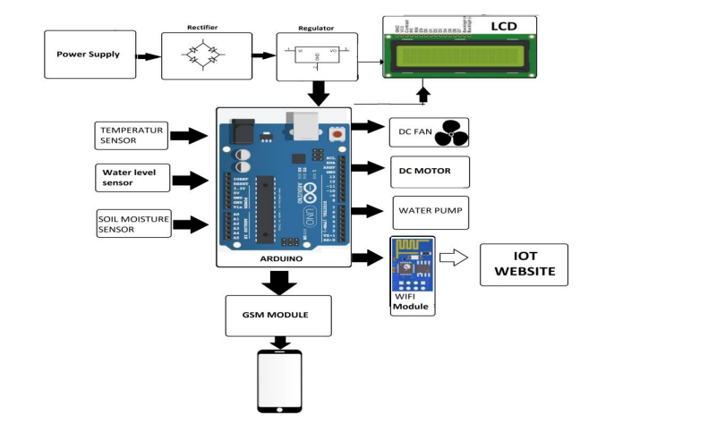
Block Diagram

